Slide 1

Permutation and Combination

Slide 2
Permutation and combinations
A permutation is an arrangement in a definite order of a number of objects taken sum or all at a time.
A combination is a selection of some or all of a number of different objects. It is an unordered collection of unique sizes.
the various ways in which objects from a set may be selected, generally without replacement, to form subsets. This selection of subsets is called a permutation when the order of selection is a factor, a combination when order is not a factor.

Slide 3
Uses of Permutation and combinations
A permutation is used for the list of data (where the order of the data matters)
The combination is used for a group of data (where the order of data doesn’t matter).

Slide 4
Two types of permutation:
Repetition is allowed: for example the number password for lock.It could be ‘’ 777’’.
No repetition: for example the first three people in a running race.you can’t be first and second.

Slide 5
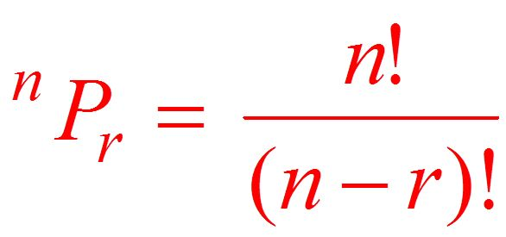
Permutations without repetition
Number of permutations of n different objects taken r at a time is:
(Where 0 < r < n)

Slide 6

Permutation example
How many different designs can be made by 3 bags from 4 bags of different colors ?
Here n = 4 and r = 3 as we need to make a combination of 3 flags out of 4 flags.
⁴P₃ = 4! / (4-3)! = 24/ (1)
= 24

Slide 7
Permutations with repetition
The permutations are:
n * n* ….(r times)
n^{r}
Number of permutations of ‘n’ different objects taken ‘r’ at a time, and repetition is allowed .

Slide 8
Permutations with repetition
Example
How many 3 letter word with or without meaning, can be formed out of the letters of the word, ‘LOGARITHMS’. If repetition of letters is not allowed?
‘LOGARITHMS’ has 10 different letters.
Hence, the number of 3-letter words (with or without meaning) formed by using these letters
= ¹⁰P₃
_{= 10* 9* 8}
₌ ₇₂₀

Slide 9
Permutations in a circle:
Sometimes, items are arranged in a circle. In this case, we no longer have a left end and a right end. The first placed item is merely a point of reference instead of having n choices.
Thus with n distinguishable objects we have (n-1)! arrangements instead of n!

Slide 10
Permutations in a circle
Example
How many six colored box can be filled in a circle ?
c = (n-1)!
c = (6-1)!
c = 120

Slide 11
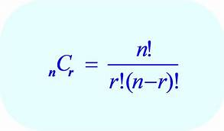
Combination formula
If the order doesn’t matter then we have a combination
(Where 0 < r < n)

Slide 12
THANK YOU

